Slide 1
CHAPTER General Equilibrium
13 and Welfare

Slide 2
Perfectly Competitive Price System
Assume that all markets are perfectly competitive price system
  There is some large number of homogeneous goods in the economy
  Each good has an equilibrium price
  There are no transaction or transportation costs
  Individuals and firms have perfect information

Slide 3
Law of One Price
A homogeneous good
  Trades at the same price no matter who buys it or who sells it
If one good traded at two different prices
  Demanders would rush to buy the good where it was cheaper
  And firms would try to sell their output where the price was higher
    These actions would tend to equalize the price of the good

Slide 4
Behavioral Assumptions
There are a large number of people buying any one good
  Each person takes all prices as given and seeks to maximize utility given his budget constraint
There are a large number of firms producing each good
  Each firm takes all prices as given and attempts to maximize profits

Slide 5
General Equilibrium
Assumptions
  There are only two goods, x and y
Demand: all individuals have identical preferences
  Represented by an indifference map defined over the quantities of the two goods
Supply: production possibility curve
  Can be used to show how outputs and inputs are related

Slide 6
Edgeworth Box Diagram for Production
Production possibility curve for x and y
  Amounts of k and l are fixed
An Edgeworth box
  Shows every possible way the existing k and l might be used to produce x and y
  Any point in the box represents a fully employed allocation of the available resources to x and y

Slide 7
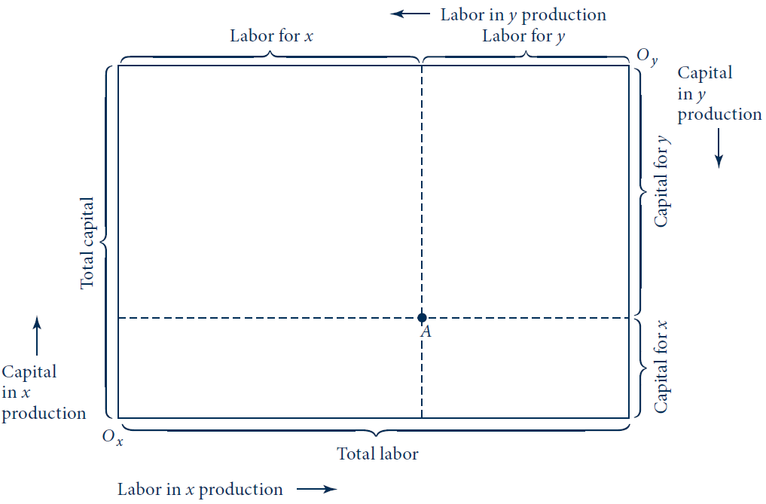
13.1 Construction of an Edgeworth Box Diagram for Production
The dimensions of this diagram are given by the total quantities of labor and capital available. Quantities of these resources devoted to x production are measured from origin O_{x}; quantities devoted to y are measured from O_{y}. Any point in the box represents a fully employed allocation of the available resources to the two goods.

Slide 8
Efficient Allocations
Many allocations in the Edgeworth box
  Are technically inefficient
    It is possible to produce more x and more y by shifting capital and labor around
Assume: competitive markets will not exhibit inefficient input choices
We want to find the efficient allocations
  They illustrate the actual production outcomes

Slide 9
Efficient Allocations
Isoquant maps for the two goods
  The isoquant map for good x uses O_{x} as the origin
  The isoquant map for good y uses O_{y} as the origin
Efficient allocations
  Will occur where the isoquants are tangent to one another

Slide 10
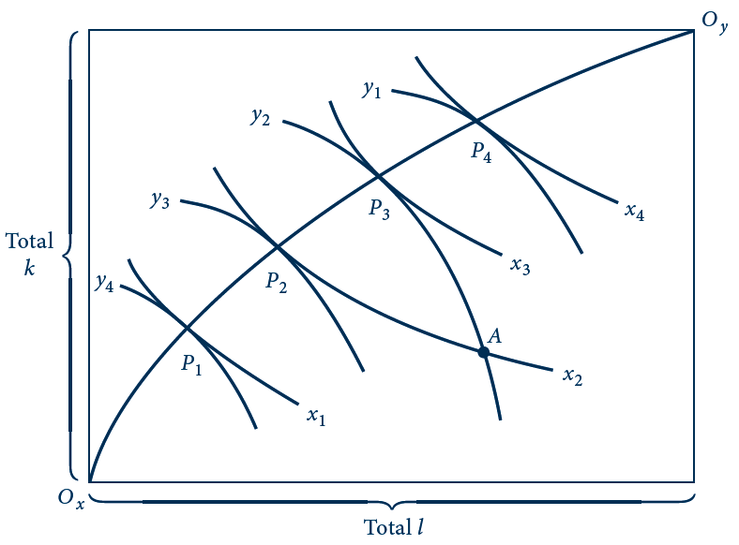
13.2 Edgeworth Box Diagram of Efficiency in
Production
This diagram adds production isoquants for x and y to Figure 13.1. It then shows technically efficient ways to allocate the fixed amounts of k and l between the production of the two outputs. The line joining O_{x} and O_{y} is the locus of these efficient points. Along this line, the RTS (of l for k) in the production of good x is equal to the RTS in the production of y.

Slide 11
Production Possibility Frontier
The locus of efficient points
  Shows the maximum output of y that can be produced for any level of x
  Use this information to construct a production possibility frontier
    Shows the alternative outputs of x and y that can be produced with the fixed capital and labor inputs that are employed efficiently

Slide 12
13.3 Production Possibility Frontier
Quantity of y
O_{x}
P₁
y₄
P₂
y₃
A
P₃
y₂
y₁
P₄
Quantity of x
x₁
x₂
x₃
x₄
O_{y}
The production possibility frontier shows the alternative combinations of x and y that can be efficiently produced by a firm with fixed resources. The curve can be derived from Figure 13.2 by varying inputs between the production of x and y while maintaining the conditions for efficiency. The negative of the slope of the production possibility curve is called the rate of product transformation (RPT).

Slide 13
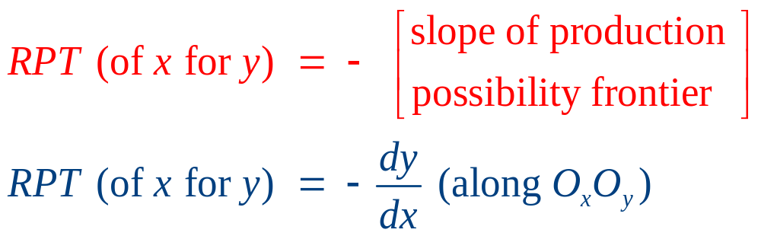
Rate of Product Transformation
Rate of product transformation (RPT) between two outputs
  The negative of the slope of the production possibility frontier
    Shows how x can be technically traded for y
    While continuing to keep the available productive inputs efficiently employed

Slide 14
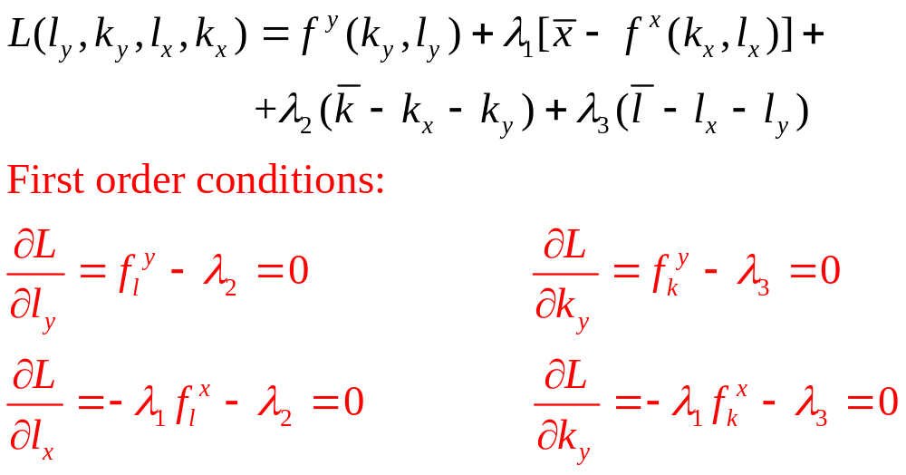
A Mathematical Derivation
  Production functions for goods x and y are f^{x}(k_{x},l_{x}) and f^{y}(k_{y},l_{y})
Lagrangian (production possibilities frontier)

Slide 15
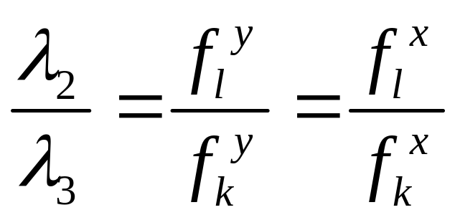
A Mathematical Derivation
For an efficient allocation of resources
  The RTS between the two inputs in y production must equal the RTS in x production

Slide 16
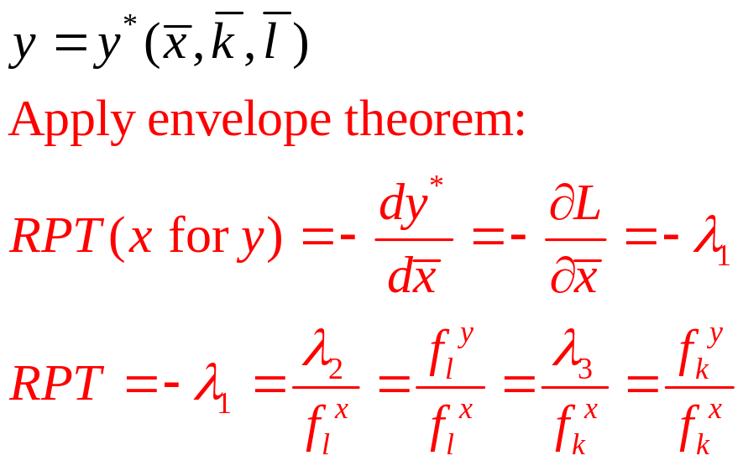
A Mathematical Derivation
Rate of product transformation, RPT
    Given by the ratios of the marginal productivities of both l and k in the production of y and x
  Value function (from the optimization problem) yields optimal y output:

Slide 17
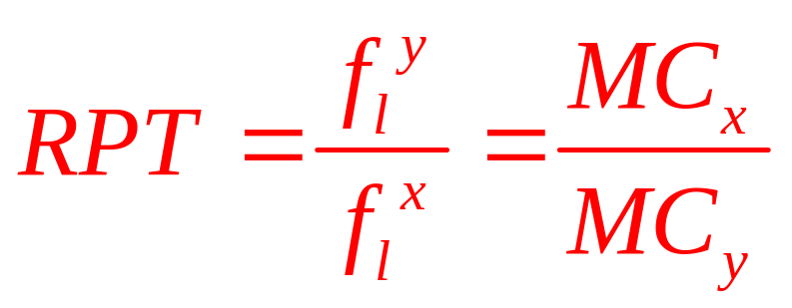
A Mathematical Derivation
Diminishing returns
  The RPT will increase as production is reallocated toward greater x output.

Slide 18
A Mathematical Derivation
Factors intensities
  From figure 13.2:
    When the inputs are efficiently allocated
    Production of good x will be “capital intensive”
      The ratio of capital to labor input will be higher in the production of good x than it is in the production of good y
  With constant returns to scale: production possibility frontier will be concave

Slide 19
A Mathematical Derivation
Non-homogeneous inputs
  Some inputs may be quite efficient in producing some goods, but not in producing others
    Another reason for believing that production possibility frontiers are concave

Slide 20
Opportunity Cost
Production possibility frontier
  Demonstrates that there are many possible efficient combinations of two goods
Opportunity cost
  Producing more of one good necessitates lowering the production of the other good

Slide 21
Opportunity Cost
The opportunity cost of one more unit of x
  Is the reduction in y that this entails
  Best measured as the RPT (of x for y)
    At the prevailing point on the production possibility frontier
    Rises as more x is produced

Slide 22
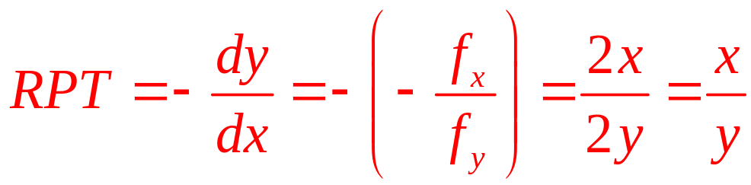
13.1 Concavity of the Production Possibility Frontier
Production of x and y
  Depends only on labor
  Production functions: x=f(l_{x})=l_{x}^{0.5} and y=f(l_{y})=l_{y}^{0.5}
  Total labor supply = 100, l_{x} + l_{y} = 100
  The production possibility frontier:
  x² + y² = 100 for x,y ≥ 0
  The RPT can be calculated:
  Concave

Slide 23
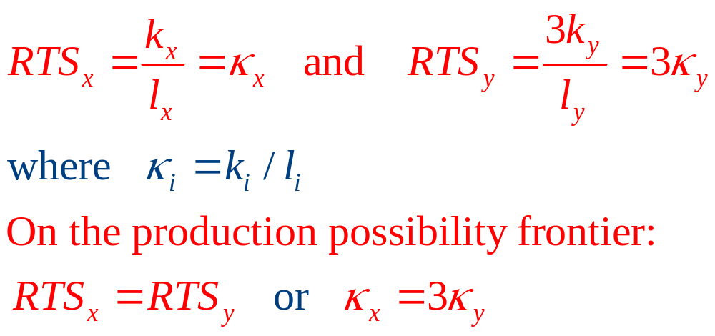
13.1 Concavity of the Production Possibility Frontier
Two goods are produced under constant returns to scale:
  Total labor and capital are constrained by:
k_{x} + k_{y} = 100, and l_{x} + l_{y} = 100

Slide 24
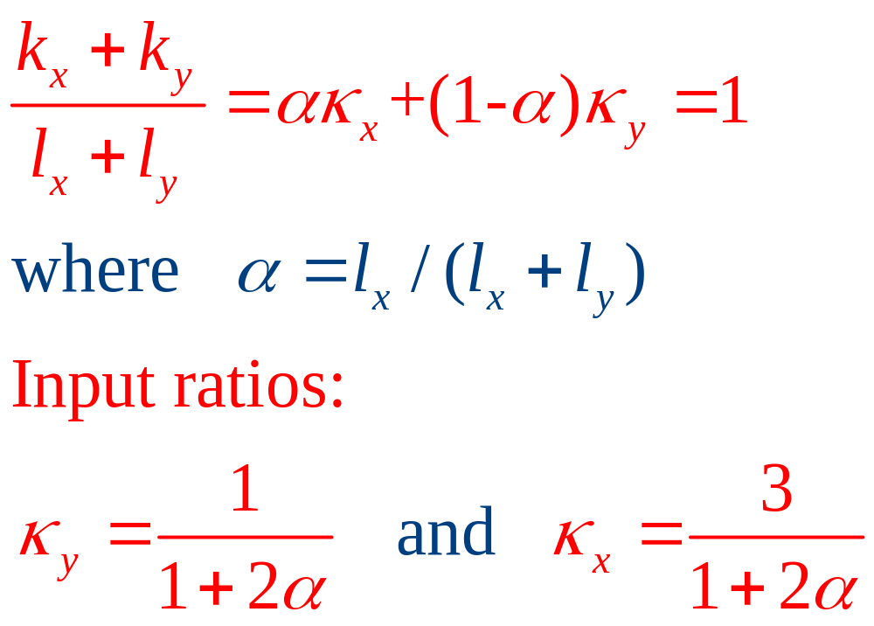
13.1 Concavity of the Production Possibility Frontier
Capital-labor ratios:

Slide 25
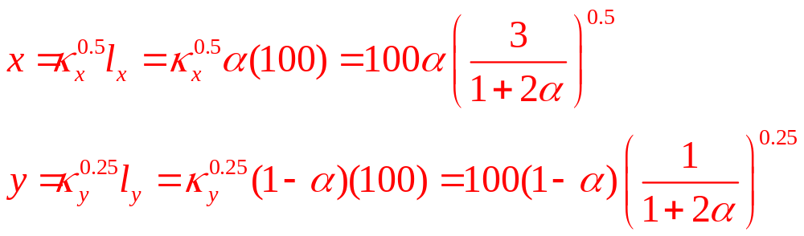
13.1 Concavity of the Production Possibility Frontier
Production possibility frontier in terms of the share of labor devoted to x production:

Slide 26
Determination of Equilibrium Prices
Determination of equilibrium prices
  From the production possibility frontier along with a set of indifference curves
The indifference curves
  Represent individuals’ preferences for the two goods

Slide 27
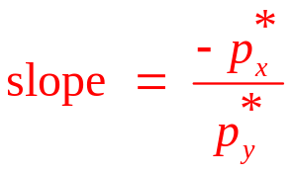
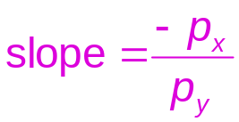
13.4 Determination of Equilibrium Prices
C*
Quantity of y
C
P
y₁
y*
E
y₁’
U₃
U₂
C
U₁
P
C*
Quantity of x
x₁
x*
x₁’
With a price ratio given by p_{x}/p_{y}, firms will produce x₁, y₁; society’s budget constraint will be given by line C. With this budget constraint, individuals demand x’₁ and y’₁; that is, there is an excess demand for good x and an excess supply of good y. The workings of the market will move these prices toward their equilibrium levels p*_{x} , p*_{y} . At those prices, society’s budget constraint will be given by line C, and supply and demand will be in equilibrium. The combination x*, y* of goods will be chosen.

Slide 28
Comparative Statics Analysis
The equilibrium price ratio
  Will tend to persist until either preferences or production technologies change
If preferences were to shift toward good x
  p_{x} /p_{y} would rise
  And more x and less y would be produced
  Move in a clockwise direction along the production possibility frontier

Slide 29
Comparative Statics Analysis
Technical progress in production of good x
  Will shift the production possibility curve outward
  This will lower the relative price of x
  More x will be consumed
    If x is a normal good
  The effect on y is ambiguous

Slide 30
13.5 Effects of Technical Progress in x Production
Quantity of y
y₁
E₁
y₀
E₀
U₁
U₀
Quantity of x
x₀
x₁
Technical advances that lower marginal costs of x production will shift the production possibility frontier. This will generally create income and substitution effects that cause the quantity of x produced to increase (assuming x is a normal good). Effects on the production of y are ambiguous because income and substitution effects work in opposite directions.

Slide 31
13.2 Comparative Statics in a General Equilibrium Model
Production possibility frontier: x ² + y ² = 100
Utility function: U(x,y) = x^{0.5}y^{0.5}
Demand functions: x = x(p_{x},p_{y},I) = 0.5I/p_{x}
and y = y(p_{x},p_{y},I) = 0.5I/p_{y}
Base-case equilibrium
  Profit maximization by firms: p_{x/}p_{y} = MC_{x}/MC_{y} = RPT = x/y
  Utility-maximizing demand : p_{x/}p_{y} = y/x
  x*=y*=7.07 and p_{x/}p_{y} =1

Slide 32
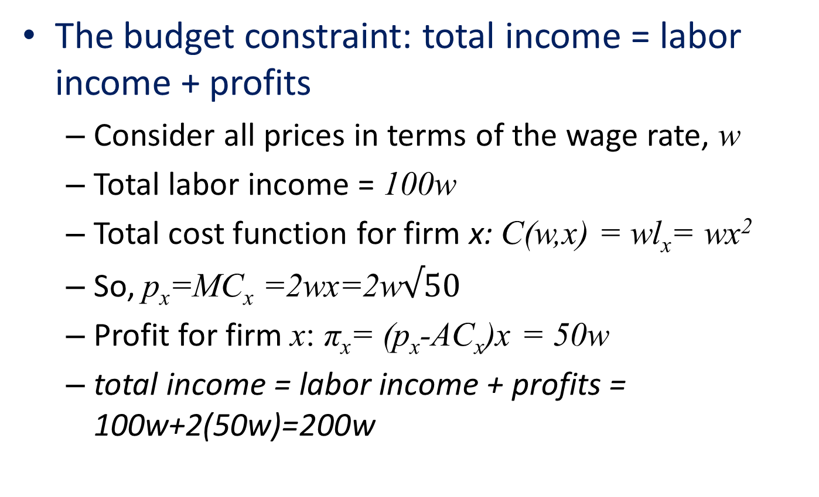
13.2 Comparative Statics in a General Equilibrium Model
The budget constraint: total income = labor income + profits
  Consider all prices in terms of the wage rate, w
  Total labor income = 100w
  Total cost function for firm x: C(w,x) = wl_{x}= wx²
  So, p_{x}=MC_{x} =2wx=2w$√50$
  Profit for firm x: π_{x}= (p_{x}-AC_{x})x = 50w
  total income = labor income + profits = 100w+2(50w)=200w

Slide 33
13.2 Comparative Statics in a General Equilibrium Model
A shift in supply
  Technical improvement in x production
  New production function, x = 2l_{x}^{0.5}
  Production possibility frontier: x²/4+y²=100
  RPT = x/4y
  Equilibrium: x*=2(50)^{0.5} , y*=(50)^{0.5} p_{x}/p_{y} = 1/2

Slide 34
13.2 Comparative Statics in a General Equilibrium Model
A shift in demand
  Consumer preferences were to switch to favor good y , U(x,y)=x^{0.1}y^{0.9}
  Demand functions: x = 0.1I/p_{x} ; y = 0.9I/p_{y}
  Equilibrium: x*=(10)^{0.5} , y*=3(10)^{0.5} p_{x}/p_{y} = 1/3

Slide 35
The Corn Laws Debate
High tariffs on grain imports
  Imposed by the British government after the Napoleonic wars
Economists debated the effects of these “corn laws” between 1829 and 1845
  What effect would the elimination of these tariffs have on factor prices?

Slide 36
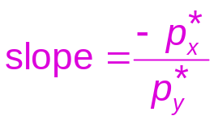
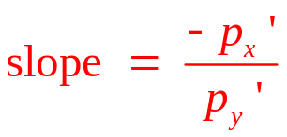
13.6 Analysis of the Corn Laws Debate
Quantity of manufactured goods (y)
y_{A}
A
y_{E}
E
B
y_{B}
U₂
U₁
Quantity of Grain (x)
x_{A}
x_{E}
x_{B}
Reduction of tariff barriers on grain would cause production to be reallocated from point E to point A; consumption would be reallocated from E to B. If grain production is relatively capital intensive, the relative price of capital would decrease as a result of these reallocations.

Slide 37
The Corn Laws Debate
Use an Edgeworth box diagram
  To see the effects of tariff reduction on the use of labor and capital
If the corn laws were repealed
  An increase in the production of manufactured goods
  A decline in the production of grain
  Harmful to capital owners
  Helpful to laborers

Slide 38
Political Support for Trade Policies
Trade policies
  May affect the relative incomes of various factors of production
In the U.S.
  Exports tend to be intensive in their use of skilled labor
  Imports tend to be intensive in their use of unskilled labor

Slide 39
A Mathematical Model of Exchange
A vector
  An ordered array of variables
    Which each may take on specific values
Convention
  The vectors we use are column vectors

Slide 40
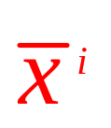
A Mathematical Model of Exchange
Model of exchange
  n goods and m individuals
  Each individual gains utility from the vector of goods he or she consumes: u^{i}(x^{i}), i = 1. . .m
  Individuals are price-takers
    Face a price vector (p) that specifies the market price for each of the n goods
  Individuals also possess initial endowments of the goods

Slide 41
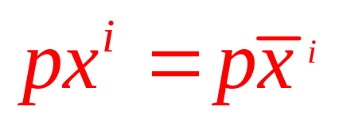
A Mathematical Model of Exchange
Model of exchange
  Each individual seeks to maximize utility
  Each individual is bound by a budget constraint
    Total amount spent on consumption = Total value of his or her endowment

Slide 42
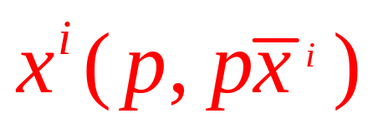
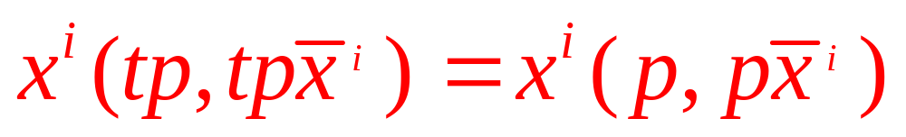
A Mathematical Model of Exchange
Set of n individual demand functions
  One for each good
  In which quantities demanded depend on all prices and income
  Continuous
  Homogeneous of degree 0 in all prices and income

Slide 43
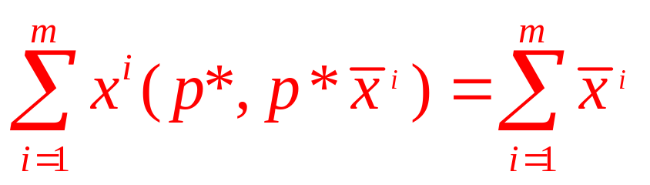
Equilibrium and Walras’ Law
Equilibrium
  Total quantities of each good demanded = Total endowment of each good available
Walrasian equilibrium
  Is an allocation of resources and an associated price vector, p*, such that
    Where the summation is taken over the m individuals in this exchange economy

Slide 44
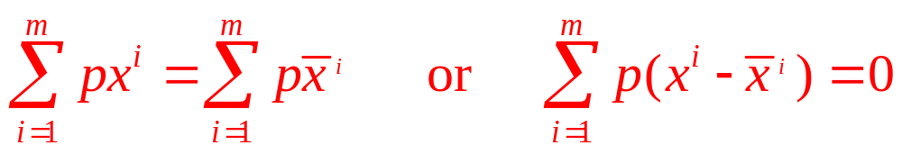
Equilibrium and Walras’ Law
Walrasian equilibrium
  In equilibrium demand equals supply in each market
Walras’ law
  The value of all quantities demanded must equal the value of all endowments

Slide 45
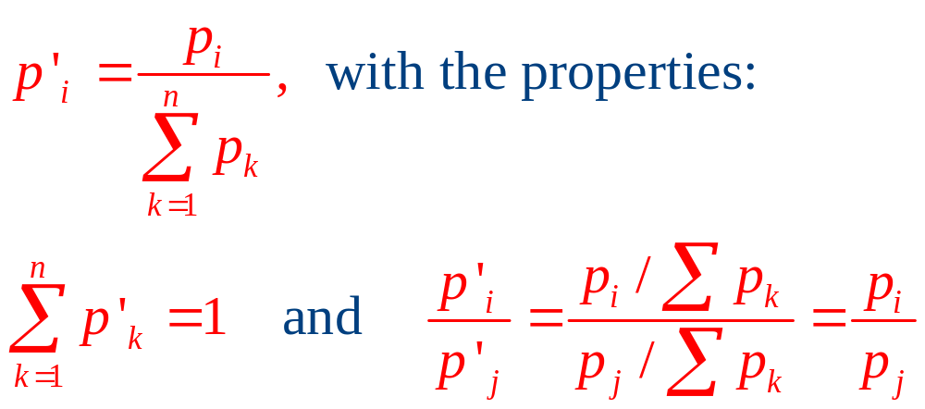
Existence of equilibrium in the exchange model
An arbitrary set of n non-negative prices p₁, p₂ . . . p_{n}
  Normalize these to form a new set of prices

Slide 46
Existence of equilibrium in the exchange model
Assume
  The price vectors we use (p) have all been normalized
Proving the existence of equilibrium prices
  Showing that there will always exist a price vector p that achieves equilibrium in all markets

Slide 47
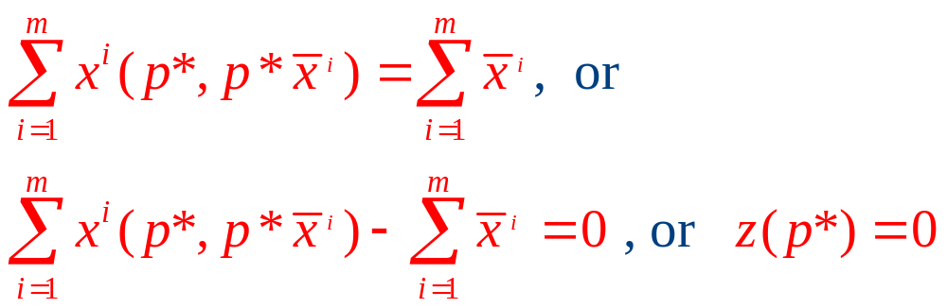
Existence of equilibrium in the exchange model
Existence of equilibrium prices
  z(p) - shorthand way of recording the ‘‘excess demands’’ for goods at a particular set of prices
    In equilibrium, excess demand is zero in all markets

Slide 48
Existence of equilibrium in the exchange model
Brouwer’s fixed point theorem
  Any continuous function from a closed compact set onto itself
    In the present case, from the ‘‘unit simplex’’ onto itself
  Will have a ‘‘fixed point’’ such that x=f(x)

Slide 49
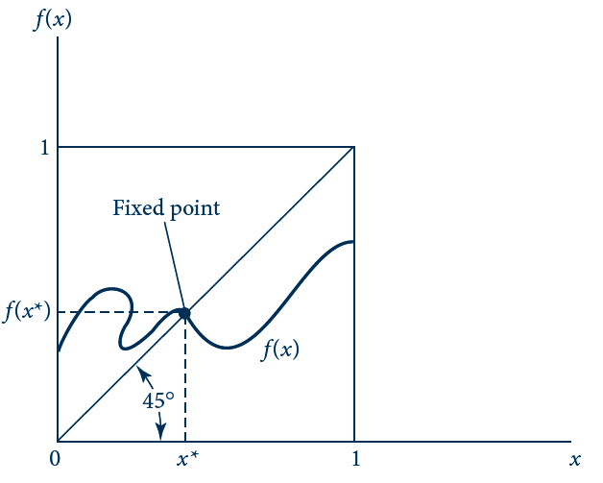
13.7 A Graphical Illustration of Brouwer’s Fixed
Point Theorem
Because any continuous function must cross the 45 line somewhere in the unit square, this function must have a point for which f (x*) = x*. This point is called a fixed point.

Slide 50
Existence of equilibrium in the exchange model
New set of prices, p₁=f(p₀)=p₀+kz(p₀)
    p₀ – arbitrary set of prices
    k – small positive constant
  Continuous function
  Will map one set of normalized prices into another
  Meet the conditions of the Brouwer’s fixed point theorem

Slide 51
Existence of equilibrium in the exchange model
The Walras proof of equilibrium price
  Let p* be the fixed point identified by Brouwer’s theorem for p₁=f(p₀)=p₀+kz(p₀)
  So, p*=f(p*)=p*+kz(p*)
  We have: z(p) = 0
  Thus, p* is an equilibrium price vector

Slide 52
Existence of equilibrium in the exchange model
The Walras proof
  Uses a number of assumptions about economic behavior
    Price-taking by all parties
    Homogeneity of demand functions
    Continuity of demand functions
    Presence of budget constraints and Walras’ law

Slide 53
First Theorem of Welfare Economics
Pareto efficient allocation
  An allocation of the available goods in an exchange economy is efficient
  If it is not possible to devise an alternative allocation in which at least one person is better off and no one is worse off
First theorem of welfare economics
  Every Walrasian equilibrium is Pareto efficient

Slide 54
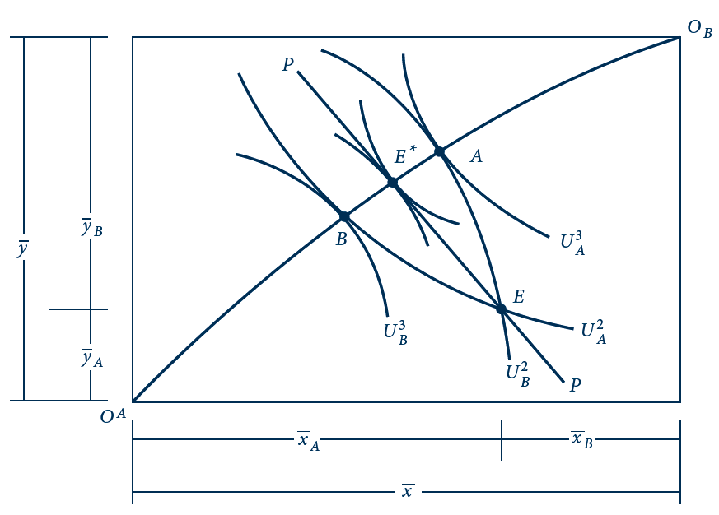
13.8 The First Theorem of Welfare Economics
With initial endowments at point E, individuals trade along the price line PP until they reach point E*. This equilibrium is Pareto efficient.

Slide 55
Second Theorem of Welfare Economics
The second theorem of welfare economics
  For any Pareto optimal allocation of resources
  There exists a set of initial endowments and a related price vector
  Such that this allocation is also a Walrasian equilibrium

Slide 56
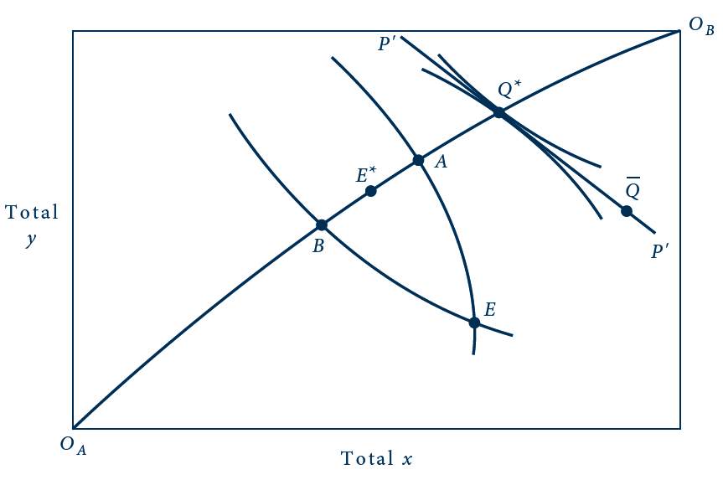
13.9 The Second Theorem of Welfare Economics
If allocation Q* is regarded as socially optimal, this allocation can be supported by any initial endowments on the price line P’P’. To move from E to, say, Q would require transfers of initial endowments.

Slide 57
13.3 A Two-Person Exchange Economy
A simple two-person, two-good exchange economy
  Total quantities of the goods are fixed:
  x = y = 1,000
  Utility functions:
  U_{A}(x_{A},y_{A}) = x_{A}^{2/3} y_{A}^{1/3} and U_{B}(x_{B},y_{B}) = x_{B}^{1/3} y_{B}^{2/3}
  Lagrangian expression
  ℒ (x_{A},y_{A}) = U_{A}(x_{A},y_{A}) +λ[U_{B}(1,000-x_{A},1,000-y_{A})-Ū_{B}]
  ℒ (x_{A},y_{A}) = x_{A}^{2/3} y_{A}^{1/3}+λ[(1,000-x_{A})^{1/3}(1,000-y_{A})^{2/3}-Ū_{B}]

Slide 58
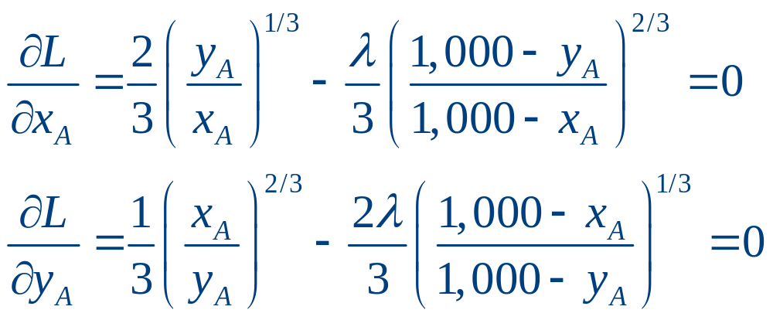
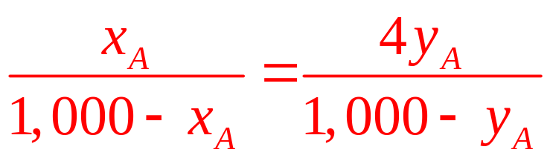
13.3 A Two-Person Exchange Economy
  First order conditions:
  We get:
  This equation allows us to identify all the Pareto optimal allocations in this exchange economy

Slide 59
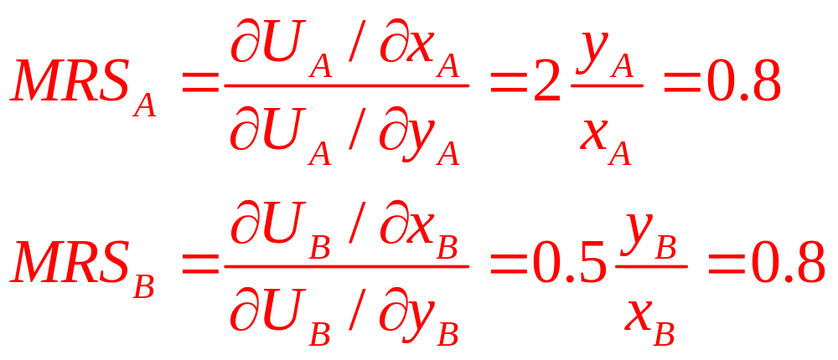
13.3 A Two-Person Exchange Economy
Equilibrium price ratio
  We need to know the marginal rate of substitution
  Therefore p_{x}/p_{y} = 0.8

Slide 60
Social Welfare Functions
Social welfare function
  Is a hypothetical scheme for ranking potential allocations of resources based on the utility they provide to individuals
  Social welfare = SW[U₁(x¹), U₂(x²), …, U_{m}(x^{m})]
  Choose allocations of goods among the m individuals in the economy in a way that maximizes SW

Slide 61
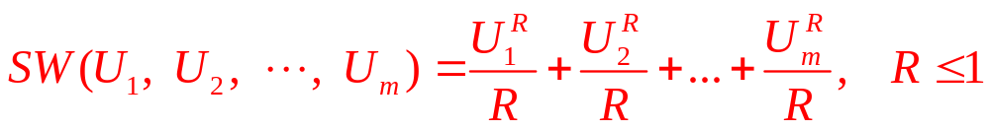
Social Welfare Functions
For the social welfare function:
For R=1: SW(U₁, U₂,…,U_{m}) = U₁+U₂+…+U_{m}
  Utilitarian function
  Social welfare is judged by the aggregate sum of utility with no regard for how utility is distributed among the members of society

Slide 62
Social Welfare Functions
For R= - ∞:
SW(U₁, U₂,…,U_{m}) =Min[U₁, U₂,…,U_{m}]
  Maximin function
  Focuses on the worse-off person in any allocation and chooses that allocation for which this person has the highest utility

Slide 63
A Mathematical Model of Production and Exchange
“Goods”
  Includes factors of production
    Whose prices also will be determined within the general equilibrium model
Labor supply
  Individuals are endowed with a certain number of potential labor hours
    Work or leisure
    Maximize utility

Slide 64
A Mathematical Model of Production and Exchange
Firms (r ) involved in production
  Bound by a production function
  Convention
    Outputs of the firm take a positive sign
    Inputs take a negative sign
  Each firm’s production plan
    An n x 1 column vector, y^{j} (j = 1 . . . r), which contains both positive and negative entries
  Maximize profits

Slide 65
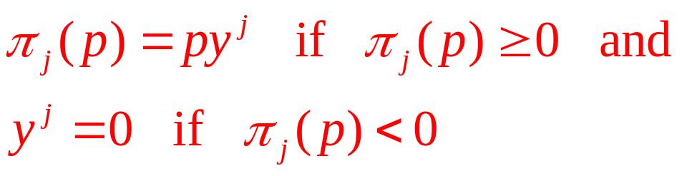
A Mathematical Model of Production and Exchange
Production functions
  Assumed to be sufficiently convex to ensure a unique profit maximum for any set of output and input prices
Profits:

Slide 66
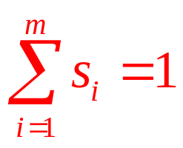
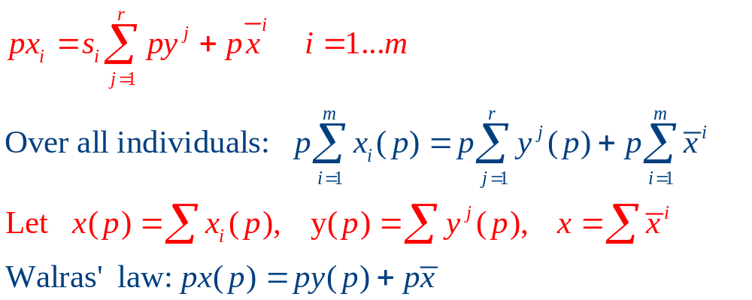
A Mathematical Model of Production and Exchange
  Each individual owns a predefined share, s_{i}, of the profits of all firms
  Each individual’s budget constraint:

Slide 67
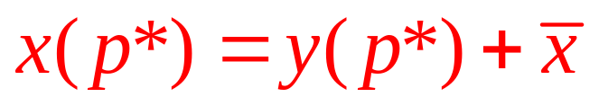
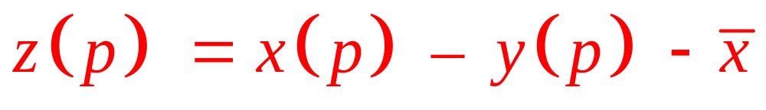
A Mathematical Model of Production and Exchange
Walrasian equilibrium price vector (p*)
  A set of prices at which demand equals supply in all markets simultaneously
Excess demand functions
  Are homogeneous of degree 0 in prices
    Any price vector for which z(p*) = 0 will also have the property that z(tp*) = 0 and t > 0

Slide 68
A Mathematical Model of Production and Exchange
Welfare economics in the Walrasian model with production
  Feasible allocations of resources
    Any point on the production possibility frontier
  The first theorem of welfare economics continues to hold
    The general social welfare implications - are far from clear

Slide 69
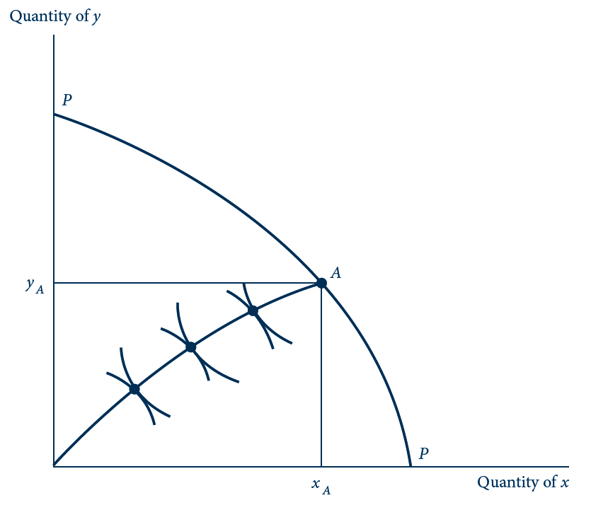
13.10 Production Increases the Number of
Feasible Allocations
Any point on the production possibility frontier PP can serve as the dimensions of an Edgeworth exchange box.

Slide 70
Computable General Equilibrium Models
Two advances - rapid development of general equilibrium models in recent years
  The theory has been generalized to include many features of real-world economies
  Expanding computer capacity has made it possible to study more complex models

Slide 71
Structure of General Equilibrium Models
Specification of general equilibrium models
  Starts by defining the number of goods to be included in the model
  The goal of the model:
    To solve for the equilibrium prices for these goods and how they may change when conditions change

Slide 72
Structure of General Equilibrium Models
The technology of firms
  Specified by production functions
Demand
  Specified by defining utility functions for various households
The model
  Must also specify how the government operates

Slide 73
Solving General Equilibrium Models
Model - solved for equilibrium prices and quantities
  Finding the solution may be difficult
  Models are generally solved on a computer using an algorithm developed by Scarf in the 1970s

Slide 74
Economic Insights from General Equilibrium Models
All prices are endogenous in economic models
  Exogenous elements are preferences and productive technologies
All firms and productive inputs are owned by households
  All income ultimately accrues to households

Slide 75
Economic Insights from General Equilibrium Models
Any model with a government sector
  Is incomplete if it does not specify how tax receipts are used
The “bottom line” in any policy evaluation
  Is the utility of households
  Firms and governments are only intermediaries in this accounting

Slide 76
Economic Insights from General Equilibrium Models
All taxes distort economic decisions along some dimension
  The welfare costs of the distortions must be weighed against the benefits of such taxes

Slide 77
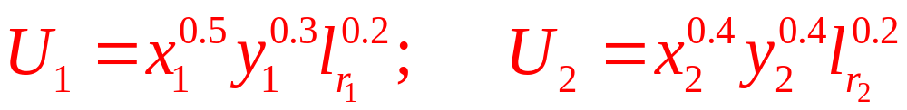
13.4 A Simple General Equilibrium Model
Assume:
  Two households, two consumer goods (x and y), and two inputs (k and l)
Households
  Each has an endowment of k and l
  Obtain utility from consuming x, y, and leisure (l_{r})
  Simple Cobb-Douglas utility functions

Slide 78
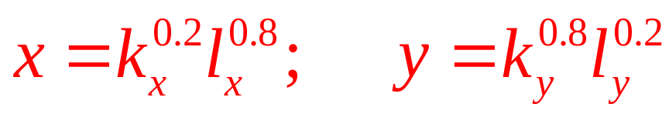
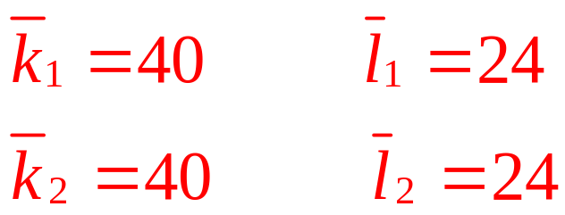
13.4 A Simple General Equilibrium Model
Production of x and y
  Cobb-Douglas technologies
Initial endowments
Model without government
  Solution will be four equilibrium prices

Slide 79
13.4 A Simple General Equilibrium Model
Price normalization scheme
p_{x} + p_{y} + p_{k} + p_{l} = 1
Solving for these prices yields
  p_{x} = 0.363; p_{y} = 0.253; p_{k} = 0.136; p_{l} = 0.248
Total production: x = 23.7; y = 25.1
Utility-maximizing choices for household 1:
  x₁ = 15.7; y₁ = 8.1; l_{r} = 9.2; U₁ = 13.5
Utility-maximizing choices for household 2:
  x₁ = 8.1; y₁ = 11.6; l_{r} = 5.9; U₁ = 8.75

Slide 80
13.5 The Excess Burden of a Tax
The government
  Imposes an ad valorem tax of 0.4 on good x
    Wedge between what demanders pay for this good x (p_{x})
    And what suppliers receive for the good
    (p’_{x} = (1 – t)p_{x} = 0.6p_{x})
Revenues generated by this tax
  Rebated to the households in a 50–50 split
New equilibrium prices
  p_{x} = 0.472; p_{y} = 0.218; p_{k} = 0.121; p_{l} = 0.188

Slide 81
13.5 The Excess Burden of a Tax
Total production: x = 17.9; y = 28.8
  Allocation of resources has shifted significantly toward y production
Utility-maximizing choices for household 1:
  x₁ = 11.6; y₁ = 15.2; l_{r} = 11.8; U₁ = 12.7
    Worse off
Utility-maximizing choices for household 2:
  x₁ = 6.3; y₁ = 13.6; l_{r} = 7.9; U₁ = 8.96
    Better off

Slide 82
Computable general equilibrium models
General methodology - Computable general equilibrium (CGE) models
  Assume various forms for production and utility functions
  Choose particular parameters of those functions based on empirical evidence
  Generate general equilibrium solutions
    Then compare with real-world data

Slide 83
Computable general equilibrium models
General methodology - Computable general equilibrium (CGE) models
  ‘‘Calibrate’’ the models to reflect reality
  Vary various policy elements in the models
    Provide general equilibrium estimates of the overall impact of those policy changes

Slide 84
Trade models
The impact of trade barriers
  Necessary to introduce a large degree of product differentiation into individuals’ utility functions
  Incorporate increasing returns-to-scale technologies into their production sectors
    Capture one of the primary advantages of trade for smaller economies
Impact of the North American Free Trade Agreement (NAFTA)

Slide 85
Tax and transfer models
Evaluate potential changes in a nation’s tax and transfer policies
  Considerable care must be taken in modeling the factor supply side
The Dutch Micro Macro Model to Analyze the Institutional Context (MIMIC model)

Slide 86
Environmental models
Understanding the ways in which environmental policies may affect the economy
  Production of pollutants - major side effect of the other economic activities
  Specify environmental goals in terms of a given reduction in these pollutants
    Economic costs of various strategies
  Study the impact of environmental policies on income distribution

Slide 87
Environmental models
Assessing CO₂ reduction strategies
  The General Equilibrium Environmental (GREEN) model
    Developed by the Organization for Economic Co-operation and Development (OECD)

Slide 88
Regional and urban models
To examine economic issues that have important spatial dimensions
  Widely used to examine the local impact of major changes in government spending policies

